Slide 1

BY
ASST. PROF. N. L. MUDEGOL

Slide 2

Backpropagation have been applied to wide variety of problems
First 3 examples are “toy problems” which are used for testing and benchmarking of network
Training set contains all possible input patterns
In later examples, training set is only a part of problem domain

Slide 3

Exclusive OR (XOR)
Parity Problem
Encoder Decoder
NETtalk and DECtalk

Slide 4

OR
inputs
XOR
output(s)
AND

Slide 5

Training set
  ((0.1, 0.1), 0.1)
  ((0.1, 0.9), 0.9)
  ((0.9, 0.1), 0.9)
  ((0.9, 0.9), 0.1)

Slide 6


Target output
0.9
0.1
Sample input
1
0.9
1
0

Slide 7

??
Actual output
???
Target output
0.9
0.1
??
Sample input
??
??
1
??
??
0.9
??
1
??
??
0

Slide 8


1
0.5
Actual output
???
Target output
0.9
0.1
1
Sample input
1
1
0.5
1
0.9
1.5
-2
1
1
0

Slide 9

Select an architecture
Randomly initialize weights
While error is too large
  Select training pattern and feedforward to find actual network output
  Calculate errors and backpropagate error signals
  Adjust weights
Evaluate performance using the test set

Slide 10

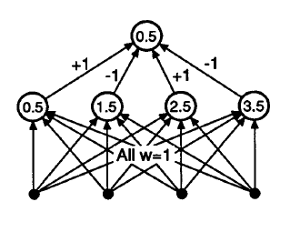
Parity Problem: Output is on if an odd number of inputs is on
0.5
1
-2
0.5
0.5
1
1
1
1

Slide 11

It is an artificial neural network used for learning efficient encoding.
The general encoding problem involves finding an efficient set of hidden unit patterns to encode a large number of input/output patterns.
The number of hidden units is intentionally made small to enforce an efficient encoding
The aim of an encoder is to learn a representation (encoding) for a set of data, typically for the purpose of dimensionality reduction.
In an encoder, the output layer has the same number of nodes as the input layer

Slide 12

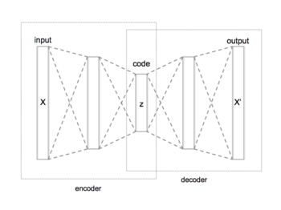

Slide 13

Network has the form N-M-N, referred as N-M-N encoder where, M<N
Example:
The network has four input units, each connected to each of the two hidden units. The hidden units are connected to each of four output units.

Slide 14

OUTPUT O O O O
HIDDEN O O
INPUT O O O O
Input patterns:
    #1 1 0 0 0
    #2 0 1 0 0
    #3 0 0 1 0
    #4 0 0 0 1
Target (output) patterns: the same

Slide 15
With η = 0.5, it converged after 973 epochs to give the results:
hidden output layer
pattern #1 0.00 0.01 0.97 0.00 0.01 0.01
pattern #2 0.99 0.98 0.00 0.97 0.01 0.01
pattern #3 0.01 0.98 0.01 0.02 0.97 0.00
pattern #4 0.96 0.00 0.01 0.02 0.00 0.97
Another run of the simulation converged after 952 epochs to give:
hidden output layer
pattern #1 0.83 0.00 0.97 0.02 0.01 0.00
pattern #2 0.99 0.95 0.01 0.97 0.00 0.01
pattern #3 0.00 0.08 0.02 0.00 0.97 0.01
pattern #4 0.04 0.99 0.00 0.01 0.01 0.97

Slide 16


Mapping character strings into phonemes so they can be pronounced by a computer
A phoneme is a sound or a group of different sounds perceived to have the same function by speakers of the language.
An example is the English phoneme /k/, which occurs in words such as cat, kit, scat, skit.

Slide 17
Neural network trained how to pronounce each letter in a word in a sentence, given the three letters before and three letters after it in a window
Output was the correct phoneme
NETtalk Example:
Course -> KORS
Bought -> BOT
Thought -> θOT

Slide 18

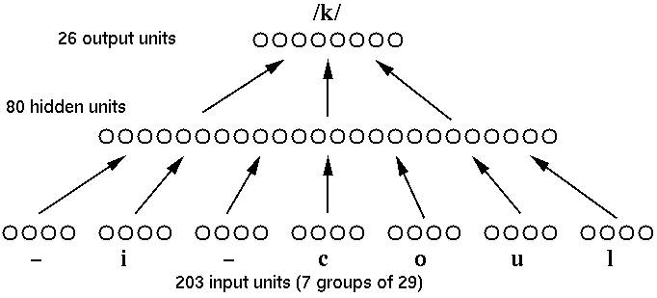

Slide 19

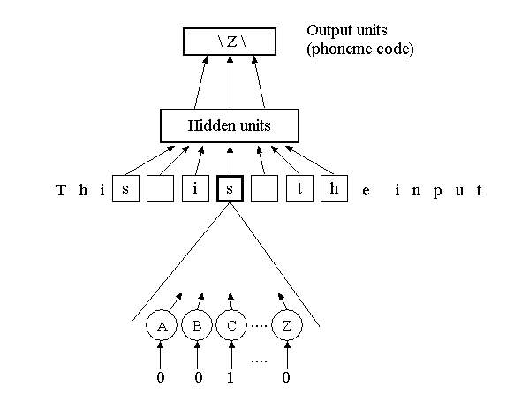

Slide 20

203 input neurons –
7 (sliding window: the character to be pronounced and the 3 characters before and after it) x
29 possible characters (26 letters + blank, full stop(.), other punctuation)
80 hidden neurons
26 output neurons – corresponding to the phonemes
203-80-26 two-layer network

Slide 21

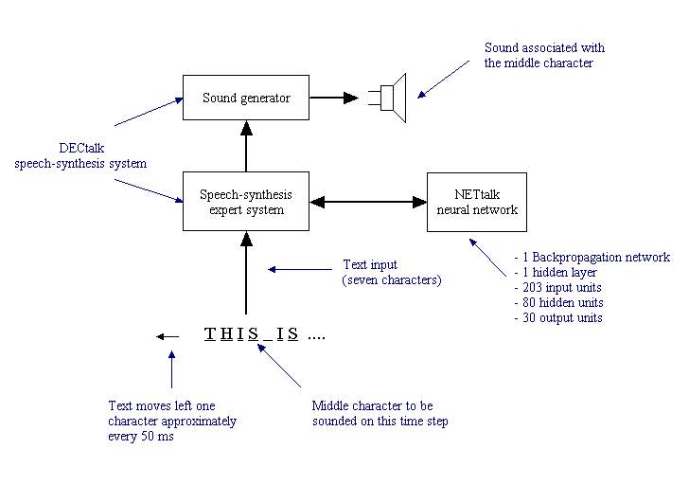
26 output units

Slide 22

Training set
Trained on 1024-words
Results
  Initially, the weights are random. So the phonemes are not correctly identified.
  Gradually when the weights are updated, it produces intelligible speech after 10 training epochs
  The network sounds like a child learning to talk
  95% accuracy on the training data after 50 epochs
  78% accuracy on the test set

Slide 23

Character Recognition
Learning Time Sequences
Sonar Target Recognition
Car Control
Face Recognition
Hand Written Zip code Recognition
Speech Recognition
Signal Prediction and Forecasting
Image Compression
Navigation of a Car

Slide 24

Purpose of Classification:
  Finding out the suitability of soil for construction of embankments, roads, buildings, dams, highways, flyovers, etc.
Each has its own requirement of soil:
  Size of particles, liquid limit, color, etc.

Slide 25

Various method/systems to classify soil.
Standard: Bureau of Indian Standards System
Another approach proposed is using Back-propagation Network.

Slide 26

1
1
2
2
1
.
.
.
.
.
.
.
.
.
6
6
Input Layer
Hidden Layer
Output Layer

Slide 27

INPUT LAYER:
  Color of soil
  Percentage of ravel
  Percentage of sand
  Percentage of fine grained particles
  Liquid Limit (WL)
  Plastic Limit (PL)

Slide 28
OUTPUT LAYER:
  Represents classification of soil based on IS classification
Both Inputs and Output values are normalized

Slide 29

CODES FOR CLASSIFICATION:
  Clayey Sand (SC): 0.1
  Clay with medium compressibility (CI): 0.2
  Clay with low compressibility (CL): 0.3
  Slit with medium compressibility (MI): 0.6

Slide 30
CODES FOR COLOR OF SOIL:
  Brown: 0.1
  Brownish Grey: 0.2
  Greyish Brown: 0.3
  Reddish Yellow: 0.5
  Yellowish Red: 0.7

Slide 31

Training Sets: 30
Iterations: 250
Learning Rate: 0.6
Momentum: 0.9

Slide 32

Error Rate found after 250th iteration: 0.0121
Rejection Rate for trained set: NIL
Rejection Rate for trained set: 8%

Slide 33

Project done by Chandra and Sudhakar.
Goal: Recognition of 0 to 9 numbers.

Slide 34

Input
Digital Image
Character of Document
Optical Scanner or Camera
Localization or Segmentation of Characters
Character Matrix
Recognition and Decision
Feature Extraction
Preprocessor
Matching
Smoothing and Normalization
Identify Character

Slide 35
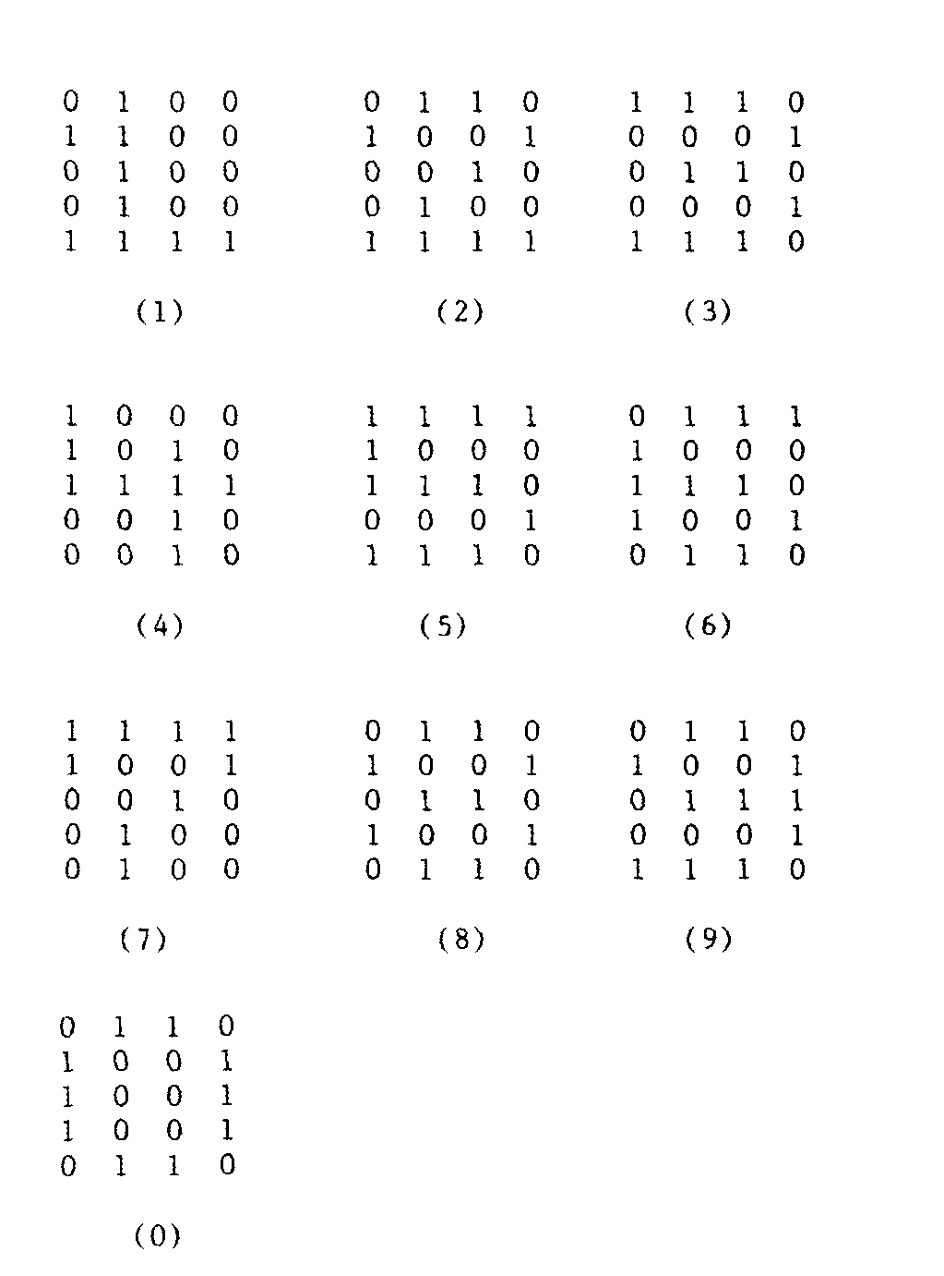


Slide 36
1
1
1
2
2
2
.
.
.
.
.
.
.
.
.
.
.
.
20
10
10
Input Layer
Hidden Layer
Output Layer

Slide 37
Training: 1000 iterations
Learning Rate: <0.5
Momentum: < a
Bias: 1.0 (fixed)

Slide 38
Machine Configuration:
  IBM PC-AT
  640 k RAM
  30 MB HDD
Neural Software Package

Slide 39

John Hertz, Anders Krogh, Richrd G. Palmer “Introduction to Theory of Neural Computation”
S. Rajasekaran and G.A. Vijayalakshmi Pai, “Neural Networks, Fuzzy Logic, and Genetic Algorithms: Synthesis and Applications”, PHI Publication (Book)

Slide 40
Jacek M. Zurada “Introduction to Artificial Neural Systems”, Jaico Publishing House (Book)
Vinod Chandra and R. Sudhakar , “Recent developments in Artificial Neural Network based character recognition: a performance study” (IEEE Paper)

